Slide 1
Streaming
COS 518: Advanced Computer Systems
Lecture 12
Michael Freedman

Slide 2
What is streaming?
Fast data!
Fast processing!
Lots of data!

Slide 3
Simple stream processing
Single node
Read data from socket
Process
Write output

Slide 4
Examples: Stateless conversion
CtoF
Convert Celsius temperature to Fahrenheit
Stateless operation: emit (input * 9 / 5) + 32

Slide 5
Examples: Stateless filtering
Filter
Function can filter inputs
if (input > threshold) { emit input }

Slide 6
Examples: Stateful conversion
EWMA
Compute EWMA of Fahrenheit temperature
new_temp = ⍺ * ( CtoF(input) ) + (1- ⍺) * last_temp
last_temp = new_temp
emit new_temp

Slide 7
Examples: Aggregation (stateful)
Avg
E.g., Average value per window
Window can be # elements (10) or time (1s)
Windows can be disjoint (every 5s)
Windows can be “tumbling” (5s window every 1s)

Slide 8
Enter “BIG DATA”

Slide 9
The challenge of stream processing
Large amounts of data to process in real time
Examples
Social network trends (#trending)
Intrusion detection systems (networks, datacenters)
Sensors: Detect earthquakes by correlating vibrations of millions of smartphones
Fraud detection
Visa: 2000 txn / sec on average, peak ~47,000 / sec

Slide 10
Scale “up”
Tuple-by-Tuple
Micro-batch
input ← read
if (input > threshold) { emit input
}
inputs ← read
out = []
for input in inputs {
if (input > threshold) {
out.append(input)
}
}
emit out

Slide 11
Scale “up”
Tuple-by-Tuple
Micro-batch
Lower Latency
Lower Throughput
Higher Latency
Higher Throughput
Why? Each read/write is an system call into kernel. More cycles performing kernel/application transitions (context switches), less actually spent processing data.

Slide 12
Scale “out”

Slide 13
Stateless operations: trivially parallelized
C
F
C
F
C
F

Slide 14
State complicates parallelization
Aggregations:
Need to join results across parallel computations
CtoF
Avg
Filter

Slide 15
State complicates parallelization
Aggregations:
Need to join results across parallel computations
CtoF
Sum
Cnt
Filter
Avg
CtoF
Sum
Cnt
Filter
CtoF
Sum
Cnt
Filter

Slide 16

Parallelization complicates fault-tolerance
Aggregations:
Need to join results across parallel computations
CtoF
Sum
Cnt
Filter
Avg
CtoF
Sum
Cnt
Filter
CtoF
Sum
Cnt
- blocks -
Filter

Slide 17
Can parallelize joins
Compute trending keywords
E.g.,
portion tweets
Sum
/ key
portion tweets
Sum
/ key
Sum
/ key
Sort
top-k
portion tweets
Sum
/ key
- blocks -

Slide 18
Can parallelize joins
Hash
partitioned
tweets
portion tweets
Sum
/ key
Sum
/ key
Sort
top-k
portion tweets
Sum
/ key
Sum
/ key
Sort
top-k
portion tweets
Sum
/ key
Sum
/ key
Sort
top-k

Slide 19
Parallelization complicates fault-tolerance
Hash
partitioned
tweets
portion tweets
Sum
/ key
Sum
/ key
Sort
top-k
portion tweets
Sum
/ key
Sum
/ key
Sort
top-k
portion tweets
Sum
/ key
Sum
/ key
Sort
top-k

Slide 20
A Tale of Four Frameworks
Record acknowledgement (Storm)
Micro-batches (Spark Streaming, Storm Trident)
Transactional updates (Google Cloud dataflow)
Distributed snapshots (Flink)

Slide 21
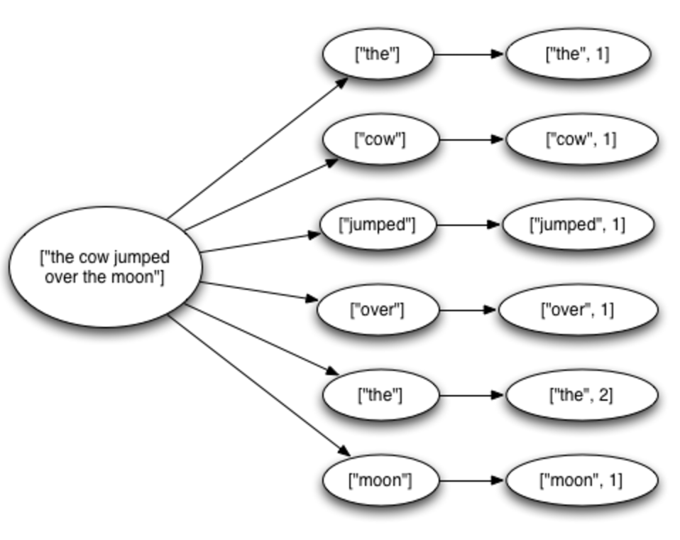
Fault tolerance via record acknowledgement (Apache Storm -- at least once semantics)
Goal: Ensure each input ”fully processed”
Approach: DAG / tree edge tracking
Record edges created as tuple processed
Wait for all edges to be marked done
Inform source of data when complete; otherwise, they resend tuple.
Challenge: “at least once” means:
Operators can receive tuple > once
Replay can be out-of-order
... application needs to handle.

Slide 22
Fault Tolerance via distributed snapshots (Apache Flink)
Rather than log each record for each operator, take system-wide snapshots
Snapshotting:
Determine consistent snapshot of system-wide state (includes in-flight records and operator state)
Store state in durable storage
Recover:
Restoring latest snapshot from durable storage
Rewinding the stream source to snapshot point, and replay inputs
Algorithm is based on Chandy-Lamport distributed snapshots, but also captures stream topology

Slide 23
Fault Tolerance via distributed snapshots (Apache Flink)
Use markers (barriers) in the input data stream to tell downstream operators when to consistently snapshot

Slide 24
But another big issue: Streaming = unbounded data
(Batch = bounded data)

Slide 25
Three major challenges
Consistency: historically, streaming systems were created to decrease latency and made many sacrifices (e.g., at-most-once processing)
Throughput vs. latency: typically a trade-off
Time: new challenge
We’ve covered consistency in a lot of detail, let’s investigate time

Slide 26
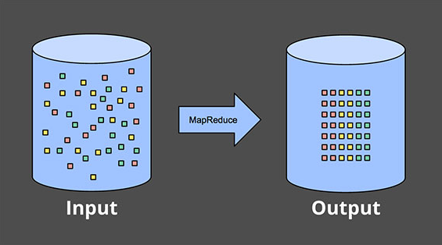
Our lives used to be easy…

Slide 27
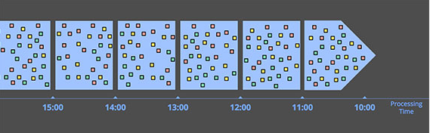
New Concerns
Once data is unbounded, new concerns:
Sufficient capacity so processing speed >= arrival velocity (on average)
Support for handling out-of-order data
Easiest thing to do:

Slide 28
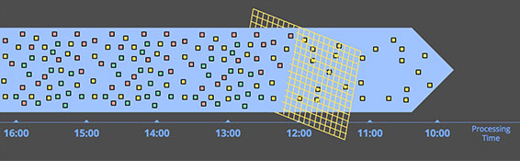
Windowing by processing time is great
Easy to implement and verify correctness
Great for applications like filtering or monitoring

Slide 29
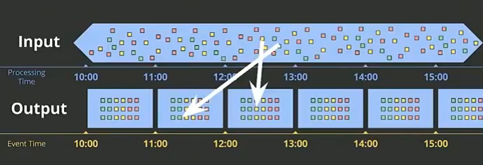
What if care about when events happen?
If we associate event times, then items could now come out-of-order! (why?)

Slide 30
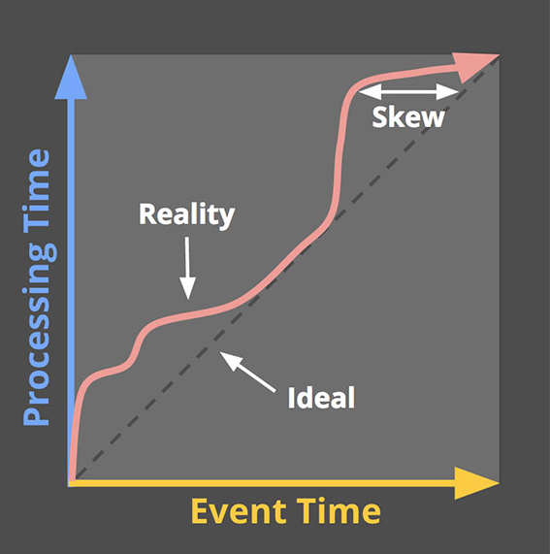
Time creates new wounds

Slide 31
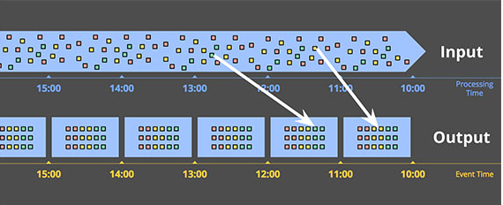
This would be nice

Slide 32
But not the case, so we need tools
Windows: how should we group together data?
Watermarks: how can we mark when the last piece of data in some window has arrived?
Triggers: how can we initiate an early result?
Accumulators: what do we do with the results (correct, modified, or retracted)?
All topics covered in next week’s readings!

